Slide 1

INTRODUCTION TO TECHNICAL WRITING

Slide 2
4 language skills
Receptive Skills
Reading
Listening
Productive Skills
Writing
Speaking

Slide 3
How would “writing” be seen separately?
Productive activity
Non-productive activity

Slide 4
Importance of writing
It helps you record history.
It helps you transmit and preserve religious and cultural values, ideologies, and views.
It helps you serve people by providing you a means via which we can share knowledge, experience, observation, insight, etc.
It helps nations grow.
It helps us guide, instruct, etc.
It helps immortalize ideas, insights, etc.
It helps preserve a particular language through codification.
It is the most appropriate medium of communication in a great majority of cases.

Slide 5


Slide 6
Let’s Compare!
B
The given image is of the main character in a Hollywood action, thriller movie John Wick, played by Keanu Reeves.
The background of the image is not as clear as that of the main character’s image. It can be predicted that the background is of a road. We cannot see the whole body image that would have been helpful in predicting if he is making a move to kill someone or have killed his enemy already, given his injuries.
Finally, the dress is timeless and quite plain, with no accompanying broche or tie clipper. He may appear as a don or a mafia.
A
The brawled and dreary look on Wick’s face, the rain and the obscured background and most of all, the never ending thirst of getting his way regardless of the fact that this may cause a toll of several other deaths; Reeves has played an impeccable role, projecting the bitterness, emptiness and indignation in his own life. Inscrutable expression on the face of the protagonist entrap the imagination of the plans he probably has, leaving questions open and disturbed.

Slide 7
Essay
Poetry
Articles
Press release
User manuals
Novels
Research papers/reports
Feasibility Studies
Reviews
Literature Reviews
G/T
G
T
T
T
G
T
T
G
T

Slide 8
Technical Communication
Technical/Professional
Business
Scientific
Subject/field specific experts produce it as it requires expertise (professional qualification/training) in the subject
It aims to run, (administer and manage) the business
It aims to report researches and discoveries to advance the field

Slide 9
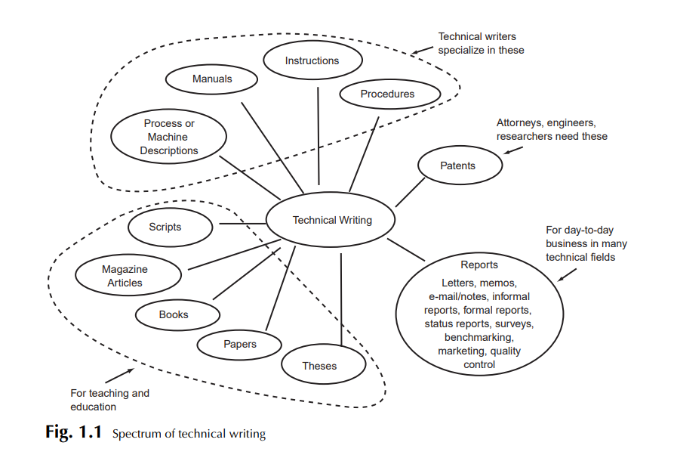

Slide 10
What is Technical Writing?
“It is a long-established and important professional activity that can be defined as a specialized field of communication whose purpose is to convey technical and scientific information and ideas accurately and efficiently.”

Slide 11
Common Purposes of Technical Writing
To Inform
To Instruct
To persuade

Slide 12
Attributes of Technical Writing
Impersonal
It does not use subjective language, nor does it have any subjective vision
Concise
It is to the point, yet focuses on every detail.
Directed
It is directed to specific audience and readers.
Archival
Written in such a manner that it can be saved, reused and revised.
Cites other Contribution
It includes all other relevant work done by different people of the same field.
Specific style and format
It has a specific style and format, which includes charts, graphs, test results theories.
Pertain to Technical Subject
It speaks for the particular and relevant subject.

Slide 13
TW as a Profession
The United States Department of Labor, recognizes technical writer as a distinct job category, stating that technical writers produce Instruction manuals and other supporting documents to communicate complex and technical information more easily. They also develop, gather, and disseminate technical information among customers, designers and manufacturers.
The Society for Technical Communication, the largest professional organization dedicated to advance in the arts and sciences of technical communication, would call a technical writer a technical communicator. Besides, a technical writer can be called as a documentation specialist, information developer.

Slide 14
The Importance of Technical Writer
In most of the cases, these reports and documents are one’s only form of communication with clients, government agencies, managers, and professionals at other facilities and companies.
The recipient will usually use the report or document to perform a task, make a decision, solve a problem, or acquire information and knowledge.

Slide 15
A technical writer should be good at/with
Subject Knowledge
Research Skills
Knowledge of the conventions of Technical Communication
Writing Skills

Slide 16
Technical Writer- job post Source Code Private Ltd
Job brief
We are looking for a Technical Writer to produce high-quality documentation that contributes to the overall success of our products. You will join a team of talented tech writers who work collaboratively with developers, quality engineers, product managers, and usability experts to make our products easier to use.
Responsibilities
Work with internal teams to obtain an in-depth understanding of the product and the documentation requirements
Produce high-quality documentation that meets applicable standards and is appropriate for its intended audience
Write easy-to-understand user interface text, online help and developer guides
Create tutorials to help end-users use a variety of applications
Analyze existing and potential content, focusing on reuse and single-sourcing opportunities
Create and maintain the information architecture
Requirements and skills
Proven working experience in technical writing
Ability to deliver high quality documentation paying attention to detail
Ability to quickly grasp complex technical concepts and make them easily understandable in text and pictures
Excellent written skills in English
Strong working knowledge of Microsoft Office
University degree in Computer Science, Engineering or equivalent preferred

Slide 17
Genres of writing
Literary
Technical
Journalistic
Academic
Creative

Slide 18
Example of literary text
'By no means!' cried Mrs. Linton in answer. 'I won't be named a dog in the manger again. You SHALL stay: now then! Heathcliff, why don't you evince satisfaction at my pleasant news? Isabella swears that the love Edgar has for me is nothing to that she entertains for you. I'm sure she made some speech of the kind; did she not, Ellen? And she has fasted ever since the day before yesterday's walk, from sorrow and rage that I dispatched her out of your society under the idea of its being unacceptable.'
'I think you belie her,' said Heathcliff, twisting his chair to face them. 'She wishes to be out of my society now, at any rate!'

Slide 19
Example of a technical text
Rapid advances in the field of artificial intelligence have profound implications for the economy as well as society at large. These innovations have the potential to directly influence both the production and the characteristics of a wide range of products and services, with important implications for productivity, employment, and competition. But, as important as these effects are likely to be, artificial intelligence also has the potential to change the innovation process itself, with consequences that may be equally profound, and which may, over time, come to dominate the direct effect.

Slide 20
Example of Journalistic Writing
AEW, the upstart pro wrestling company currently riding unprecedented momentum, offers what is expected to be their biggest pay per view in its short history with All Out set to take place tomorrow evening from the Now Arena in Hoffman Estates, Illinois, a Chicago suburb. An outstanding card…

Slide 21
Example of academic writing
Having been taboo for decades, if not centuries, mental health is now being widely discussed. During these exceptional times of pandemic, many of us are confronted with psychological problems related to isolation, anxiety, loneliness, frustrations, addictions, insecurities, depression, fears and worry – issues regularly addressed by Krishnamurti. Throughout his talks and discussions, Krishnamurti reveals that we are conditioned to have problems and that taking them personally may be a fundamental error. Moreover, the realisation that one’s loneliness, for example, is common to all humanity, is essential to understanding it, being free of it and learning what it is to be fundamentally secure and well in an uncertain world

Slide 22
Example of creative writing
“You are an extremely lucky person”, said the elderly woman who had the sparkling golden and black bandana wrapped around her head in a turban. Her dreadlocks with beads at the end were jingling back and forth, as she was talking and gazing at me with her black kohl eyes.
“You are going to be rich, and your future destination will be Chile”.
I opened my eyes; I was exasperated as I woke up. What? Chile? Wasn’t it supposed to be South Korea?
Fortune tellers! Huge respect. Has anyone ever realized how much effort they need to put into convincing us about our future that we desperately want to know? Not to forget about their generosity that they even tell us things which we would never want to know. For example, I was once told by a random woman at a wedding that I am going to die in two years, seven years ago. And to my dismay, If I ever cross paths with her again, I’d like to scream on top of my lungs and ask her, “What sorcery is this?

Slide 23
Common Purposes of Technical Writing
To give information (It is the primary purpose of TW)
To analyze and interpret events and their implications
To persuade and influence decisions

Slide 24
DIFFERENCE BETWEEN TECHNICAL AND LITERARY WRITING
Point of reference | Technical | Literary
Rule-governed | It has its own set of rules and practices. It presents a formal order or structure for conveying ideas. | It is experimental.
Organization | Highly well-organized and logically structured. Follows the patterns and conventions for different text types strictly. | It can be loosely organized.
Clarity | It possesses high degree of clarity. All messages are delivered directly and explicitly. Writers’ purpose and theme is clearly indicated in the very first paragraph. | It can be implicit and covert. It may challenge the reader’s intellect to discover the writer’s objectives and key ideas.
Grammatical Accuracy | It adheres to traditional conventions of punctuation, grammar, and spelling completely. | It tries to do the same.

Slide 25
Point of reference | Technical | Literary
Tone and Style | It has a formal tone. The writer appears objective, tolerant, and serious. Sentences may be complex. | It can have variety of tones and styles, like, formal, informal, humorous, sarcastic, poetic, emotional, friendly, casual, conversational etc
Stylistic Devices | It is more straight forward and down to earth. | It uses plenty of stylistic devices, like, metaphors, similes, irony, puns, oxymoron, etc.
Vocabulary | It uses standard language in order to develop the formal tone and attitude which is the hallmark of technical writing. It may use technical words. | It can use vocabulary belonging to different language varieties depending on the audience and tone.

Slide 26
Point of reference | Technical | Literary
Content | It is usually based on factual, straightforward, specialized topics. | It can choose from a wide variety of topics, ranging from very important to less significant things in life.
Authenticity | It always informs readers about the sources from where it collects information. | Sources might be clear, or unclear, or sometimes not mentioned at all.
Use of Visual Aids | It uses tables, graphs, figures to facilitate comprehension of facts, statistics, and data | Pictures might be used, but rarely.
Summary | Informative, unemotional, limited interpretation possible. | Entertains, amuses, appeals to imagination and emotions. Suggestive, creative, dramatic, imaginative, metaphoric. Various interpretations possible.

